Slide 1
SAP BTP Extension Suite Training
Day 22
Anubhav Oberoy
www.AnubhavTrainings.com
Follow excellence with sheer passion

Slide 2


DISCLAIMER
The training content and delivery of this presentation is confidential, and cannot be recorded, or copied and distributed to any third party, without the written consent of Anubhav Trainings

Slide 3
Agenda – Day 22
01
Introduction to type script
02
Working with interfaces and types
03
Working with classes

Slide 4

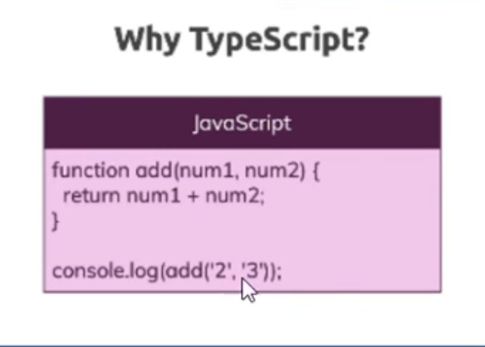
What is Type Script
Type Script is enhanced version of JS, TypeScript is a syntactic superset of JavaScript which adds static typing.
We could say its superset of JS
You can think like C++ is enhanced version of C
TypeScript is built upon Java Script only
TS = JS + Types, Like usually in JS we never provide data types while creating variables but in TS we must
Also TS offers better syntax to manage the classes and objects
TS cannot run directly in Browser, so it has to be converted to JS hence we have to write some special file or use modules to convert the TS to JS at runtime
TS Compiler converts the code from TS to JS
Benefits
We can do checks at compile time, So error handling is easy
Code Completion is better
Object Oriented programming can be added which offers classes, polymorphism, inheritance etc
Example when we define return type for the function @ design time which helps us to find compile time
History
Developed by Microsoft by enhancing JS
First released in Oct-2012 and influenced by JS
7
www.anubhavtrainings.com
7

Slide 5
Variable Creation
The most basic types in TypeScript are called primitives.
These types form the building blocks of more complex types in your applications.
TypeScript includes all JavaScript primitives plus additional type features.
Here are the five primitive types you'll use most often:
let varName : datatype = value;
let isActive: boolean = true; let hasPermission = false; // TypeScript infers 'boolean' type
let decimal: number = 6; let hex: number = 0xf00d; // Hexadecimal let binary: number = 0b1010; // Binary let octal: number = 0o744; // Octal let float: number = 3.14; // Floating point
let color: string = "blue"; let fullName: string = 'John Doe'; let age: number = 30; let sentence: string = `Hello, my name is ${fullName} and I'll be ${age + 1} next year.`;
7
www.anubhavtrainings.com
7

Slide 6
How to run TS code in VS Code/BAS
TypeScript is a superset of JavaScript that adds features such as data types, interfaces, classes, and compile-time error checking. Since browsers and Node.js understand JavaScript, TypeScript code must first be converted (compiled) into JavaScript before it can be executed. Visual Studio Code provides excellent support for TypeScript development, including syntax highlighting, IntelliSense, debugging, and terminal integration. To work with TypeScript, developers typically install Node.js, TypeScript, and optionally ts-node, which allows TypeScript files to be executed directly without manually compiling them.
TypeScript can be installed globally using npm. This provides access to the TypeScript Compiler (tsc) from any terminal window.
npm install -g typescript --Install TypeScript
tsc hello.ts --The TypeScript Compiler (tsc) converts .ts files into .js files that can be executed by Node.js.
node hello.js --Run the Generated JavaScript File:
Instead of compiling manually every time, developers often use ts-node, which compiles and executes TypeScript in a single step.
npm install -g ts-node
ts-node hello.ts
7
www.anubhavtrainings.com
7

Slide 7
Special Types
The 'any' type allows you to opt-out of type checking for a variable. It can hold any value, and you can perform any operation on it without TypeScript raising an error.
The 'unknown' type is similar to 'any' in that it can hold any value, but it is safer because you cannot perform operations on it without first checking its type.
Working with arrays - let arrName: dataType[] = [];
Tuple, A tuple is a typed array with a pre-defined length and types for each index. Tuples are great because they allow each element in the array to be a known type of value.
Object - TypeScript has a specific syntax for typing objects.
Type Guard
A Type Guard in TypeScript is a technique used to check the type of a variable at runtime so that TypeScript can safely narrow the variable's type within a specific block of code.
7
www.anubhavtrainings.com
7

Slide 8
Type Annotations and Inference
TypeScript offers two ways to work with types:
Explicit Typing: You explicitly declare the type of a variable
Type Inference: TypeScript automatically determines the type based on the assigned value
When to Use Each Approach
Use explicit types for:
Function parameters and return types
Object literals
When the initial value might not be the final type
Use type inference for:
Simple variable declarations with immediate assignment
When the type is obvious from the context
// String greeting: string = "Hello, TypeScript!"; // Number userCount: number = 42; // Boolean isLoading: boolean = true; // Array of numbers scores: number[] = [100, 95, 98];
// Function with explicit parameter and return types function greet(name: string): string { return `Hello, ${name}!`; } // TypeScript will ensure you pass the correct argument type greet("Alice"); // OK greet(42); // Error: Argument of type '42' is not assignable to parameter of type 'string'
7
www.anubhavtrainings.com
7

Slide 9
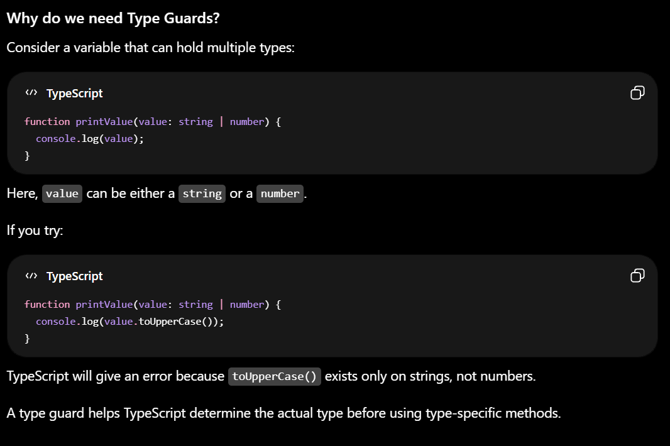
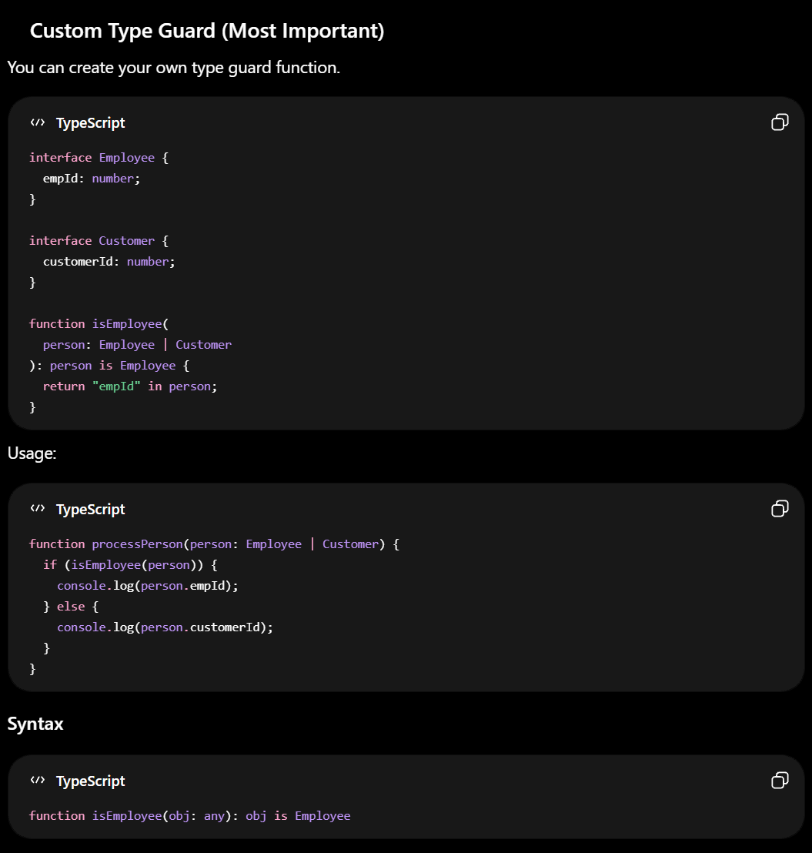
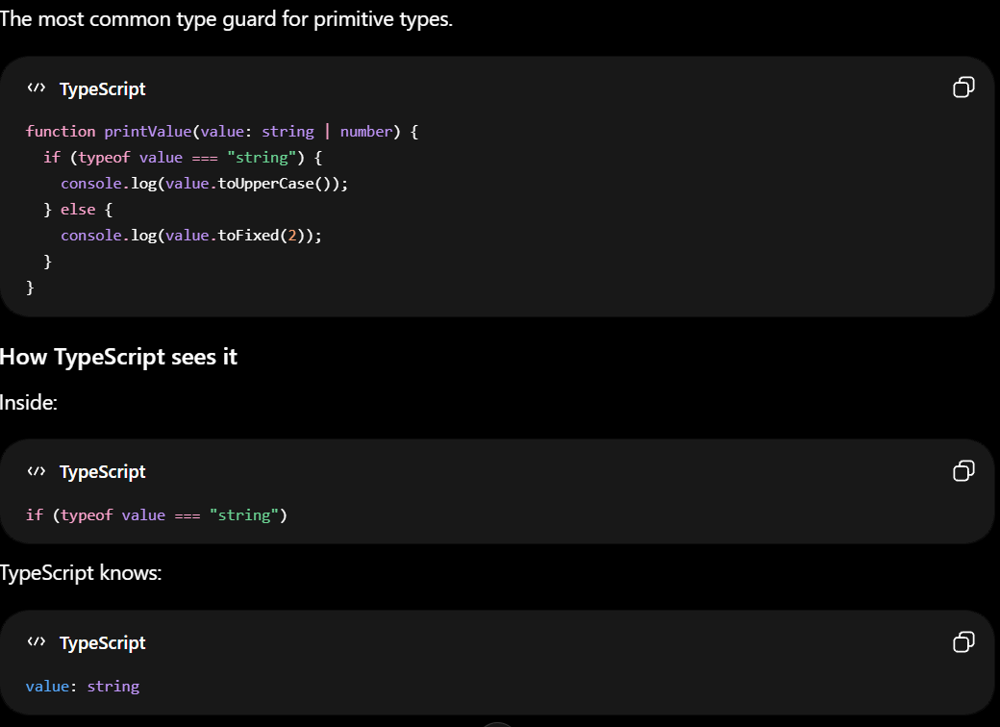
Type Guard
A Type Guard in TypeScript is a technique used to check the type of a variable at runtime so that TypeScript can safely narrow the variable's type within a specific block of code.
7
www.anubhavtrainings.com
7

Slide 10
TypeScript Type Aliases and Interfaces
Extending: Both can be extended, but interfaces support declaration merging.
Unions/Intersections: Only type aliases support union and intersection types.
Implements: Classes can implement either.
Recommendation: Use interface for objects, type for everything else.
Best Practices:
Use interface for defining object shapes and public APIs.
Use type for unions, intersections, and primitives.
Favor composition over inheritance for types.
Document your types and interfaces for clarity.
Common Pitfalls:
Using type when you need declaration merging (use interface).
Overcomplicating types-keep them simple and focused.
Forgetting to update types/interfaces as code evolves.
7
www.anubhavtrainings.com
7

Slide 11
TypeScript Definitely Typed
NPM packages in the broad JavaScript ecosystem don't always have types available.
Sometimes the projects are no longer maintained, and other times they aren't interested in, agree with, or have time to use TypeScript.
Using untyped NPM packages with TypeScript is not type-safe because types are missing.
To help TypeScript developers use such packages, there is a community-maintained project called Definitely Typed.
https://www.npmjs.com/package/@openui5/types
This npm package contains the TypeScript type definitions based on ES modules for all the OpenUI5 libraries.
These definitions can be used to:
Enable advanced content assist in IDEs, e.g: (VSCode / IntelliJ / Webstorm) for OpenUI5.
Integrate type checking for OpenUI5 applications using the TypeScript compiler.
These capabilities are available not only for OpenUI5 apps written in TypeScript, but to some degree also in JavaScript.
NOTE: "based on ES modules" means that the application code needs to load UI5 modules using the ES6 modules syntax and needs to be transformed to standard UI5 require/define syntax before it is executed. This is the recommended approach!
7
www.anubhavtrainings.com
7

Slide 12
TypeScript Configuration – tsconfig.json
The tsconfig.json file is the heart of every TypeScript project.
It tells the TypeScript compiler how to process your code, which files to include, and which features to enable or disable.
A well-configured tsconfig.json ensures a smooth developer experience and reliable builds.
compilerOptions: Controls how TypeScript compiles your code (e.g., target, module, strictness).
include: Files or folders to include in the compilation.
exclude: Files or folders to exclude.
files: Explicit list of files to include (rarely used with include).
extends: Inherit options from another config file.
references: Enable project references for monorepos or multi-package setups.
Use command tsc --init generate the tsconfig.json file
7
www.anubhavtrainings.com
7

Slide 13
Why Use TypeScript with Node.js?
TypeScript brings static typing to Node.js development, providing better tooling, improved code quality, and enhanced developer experience.
Key benefits include:
Type safety for JavaScript code
Better IDE support with autocompletion
Early error detection during development
Improved code maintainability and documentation
Easier refactoring
mkdir my-ts-node-app cd my-ts-node-app npm init -y npm install typescript @types/node --save-dev npx tsc –init
7
www.anubhavtrainings.com
7

Slide 14
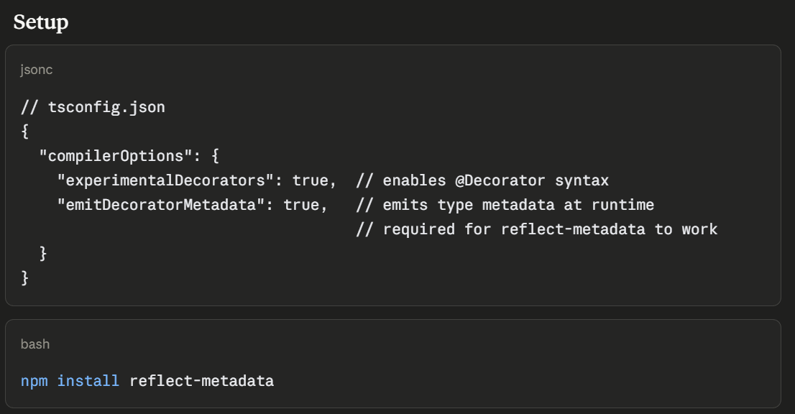
Decorators and Metadata reflection
Decorators are special functions prefixed with @ that attach to classes, methods, properties, or parameters and add behavior without modifying the original code — similar to Java Annotations or Python Decorators.
Metadata Reflection (reflect-metadata) lets decorators read/write hidden metadata about classes at runtime — used heavily by frameworks like NestJS, TypeORM.
7
www.anubhavtrainings.com
7

Slide 15
Utility types
Utility types are built-in generic types that transform existing types into new ones — no need to rewrite interfaces from scratch.
They're like type factories—you feed in a type, and out comes a new type with different properties.
Think of it like this: if you have a blueprint for a house, utility types let you create variations—a blueprint with fewer rooms, optional walls, readonly doors, etc.—without rewriting everything from scratch.
7
www.anubhavtrainings.com
7

Slide 16
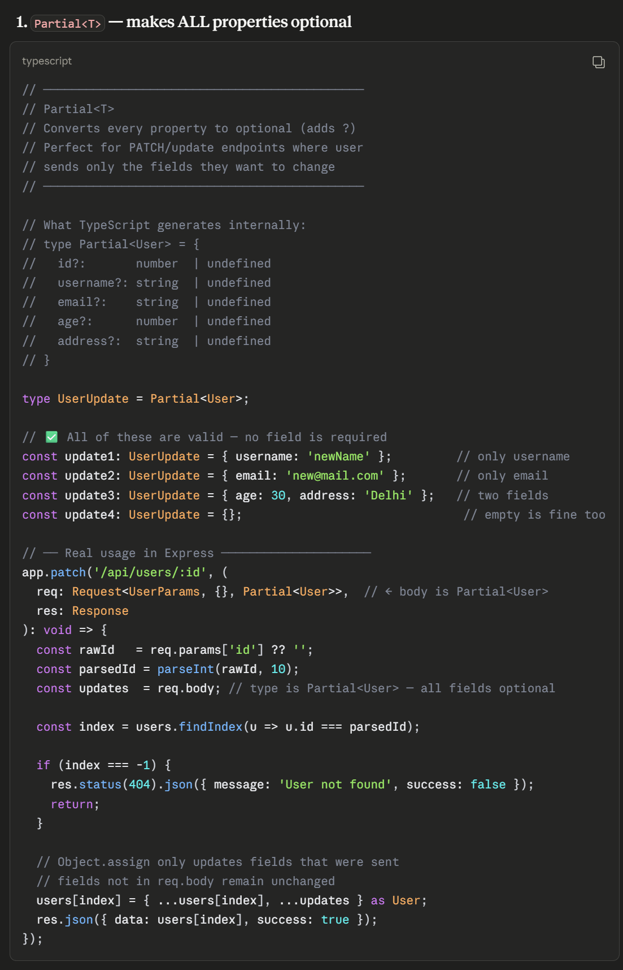
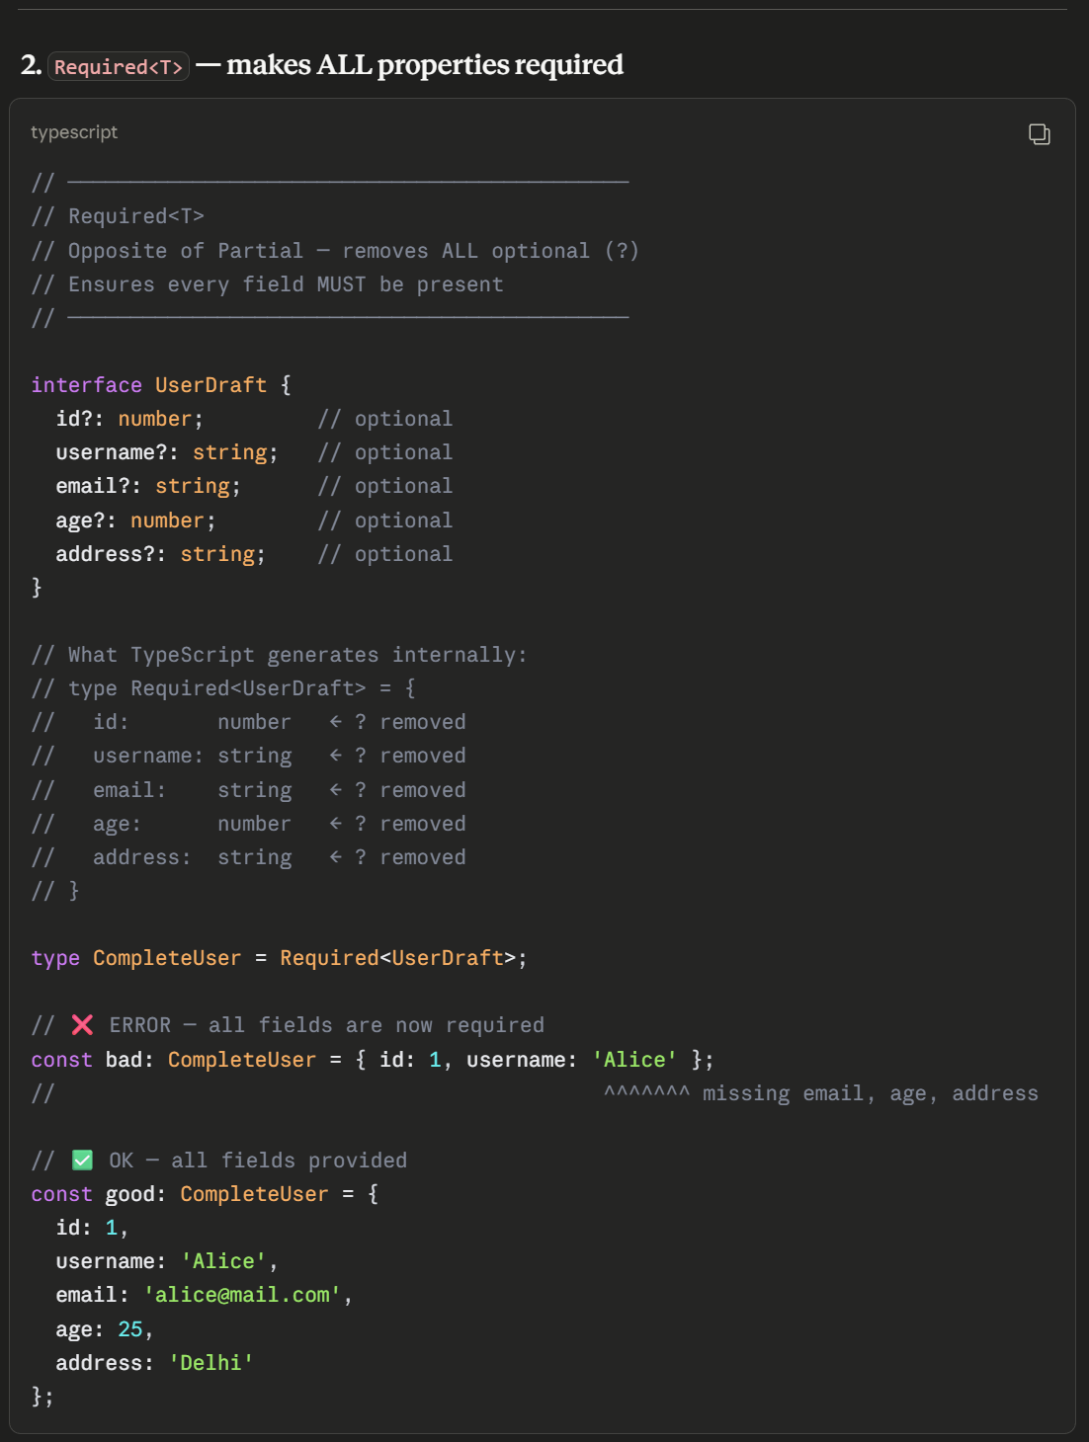
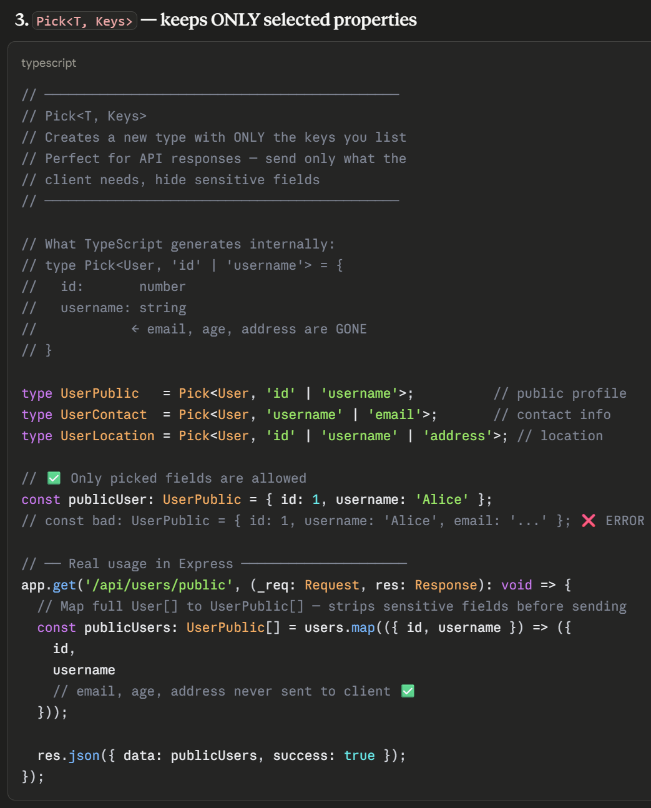
Partial, Required, Pick
Text
7
www.anubhavtrainings.com
7

Slide 17
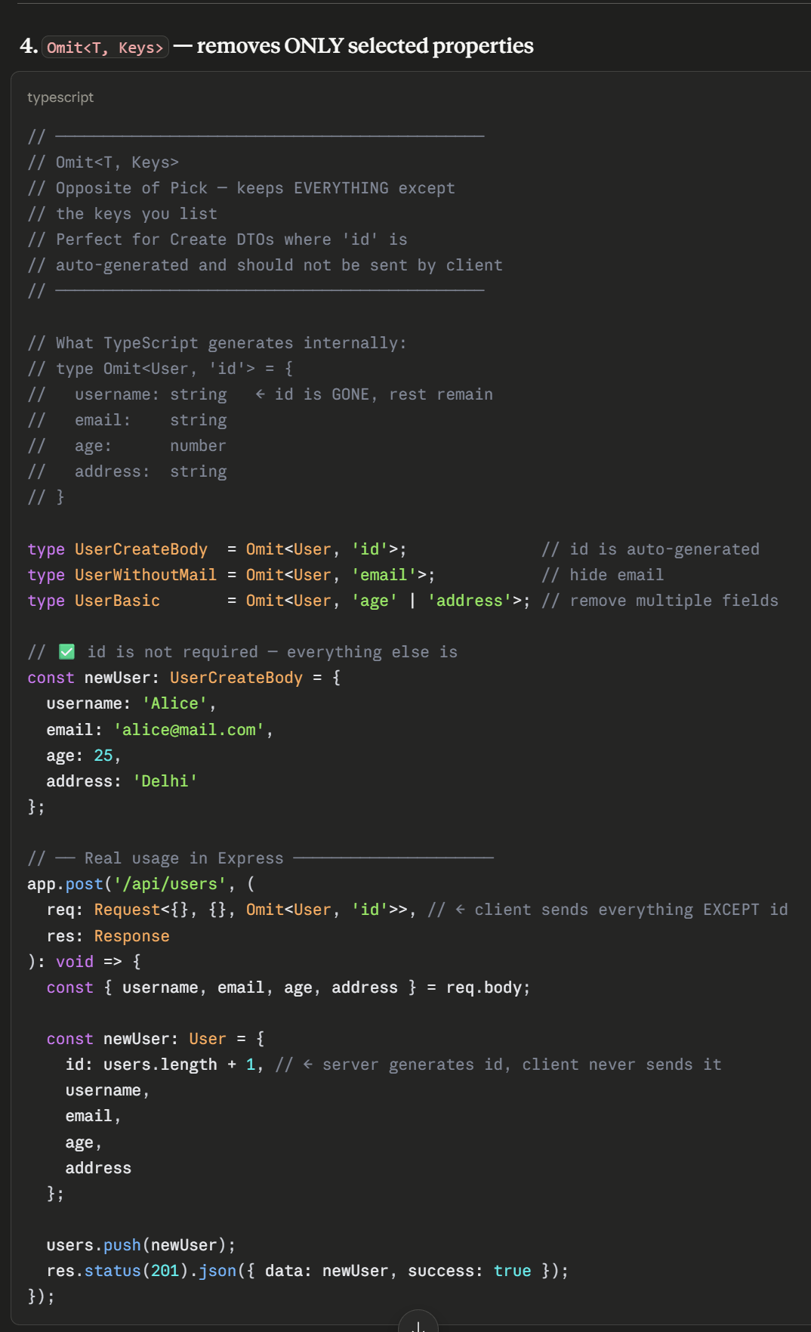
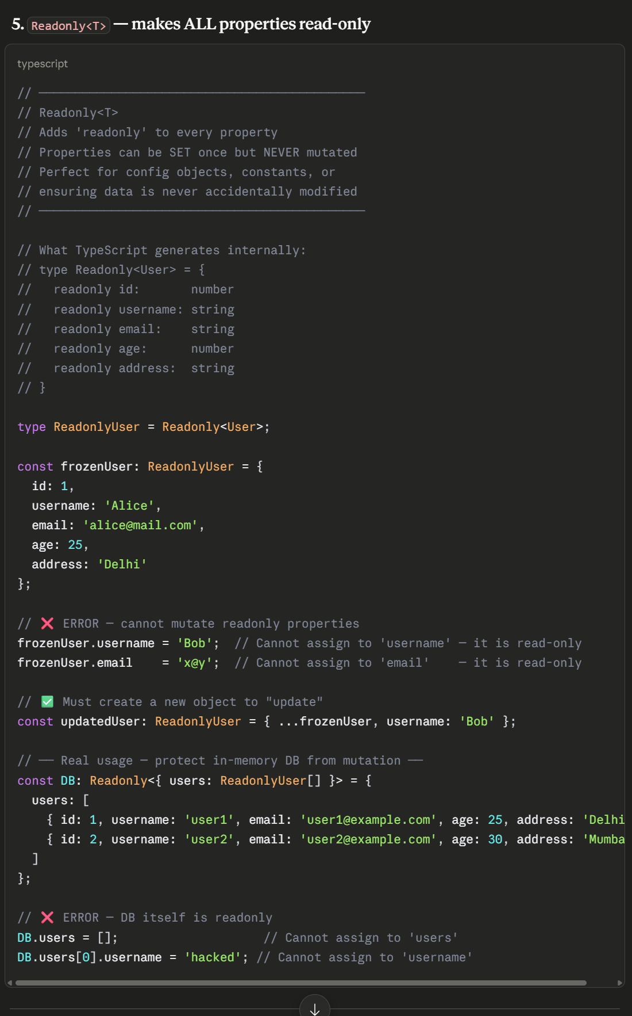
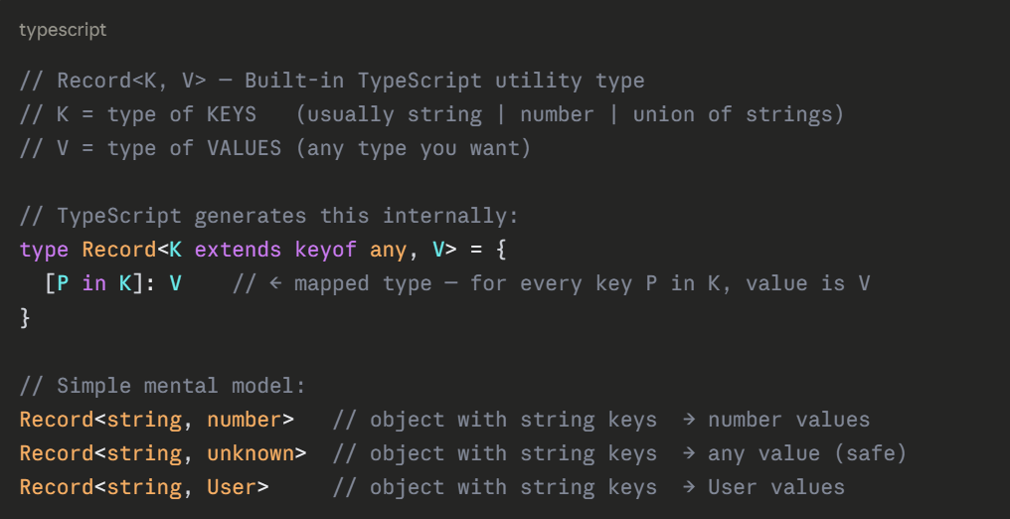
Omit and ReadOnly
7
www.anubhavtrainings.com
7

Slide 18
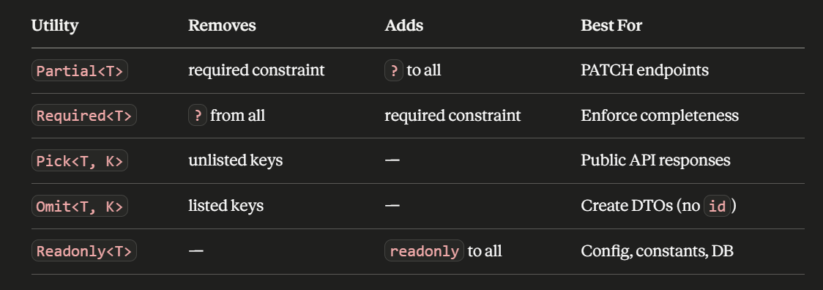
Summary
7
www.anubhavtrainings.com
7

Slide 19

What We Did
Let’s Summarize

Slide 20

www.anubhavtrainings.com
Thank You
End of Day 20

Slide 21


We’re committed to empower you to be
#FutureReady
through powerful training solutions.
We build the workforce of the future.
260+
Corporate Clients
60,000+
Learners Trained
26000+
Learners Placed
FREE WEBINARS
Sign up for free webinars with industry experts every fortnight!
Enroll Now!
Contact us today!
https://anubhavtrainings.com

